Slide 1
Real Estate Masters Summit
With Ardor SEO

Slide 2
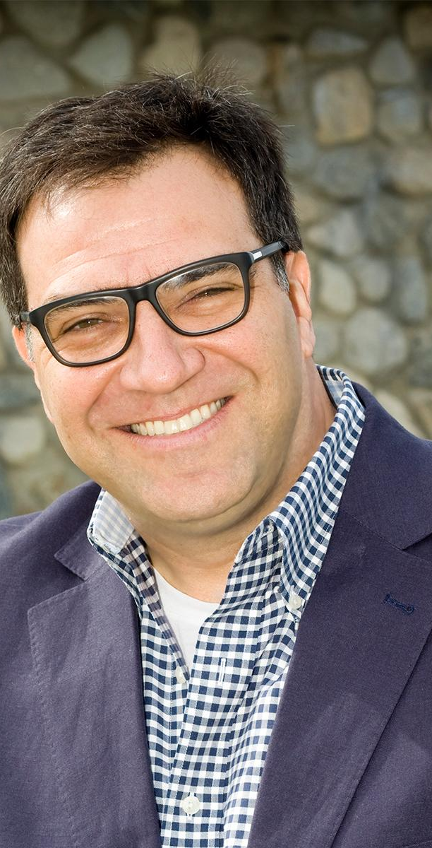
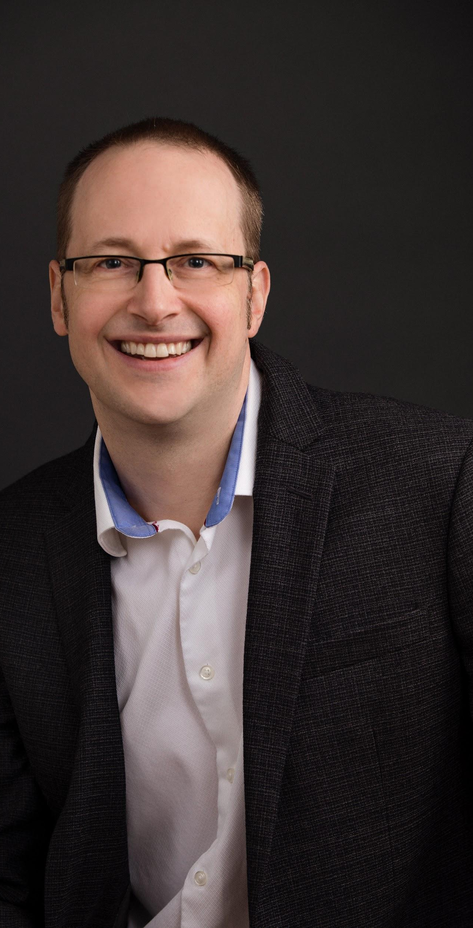
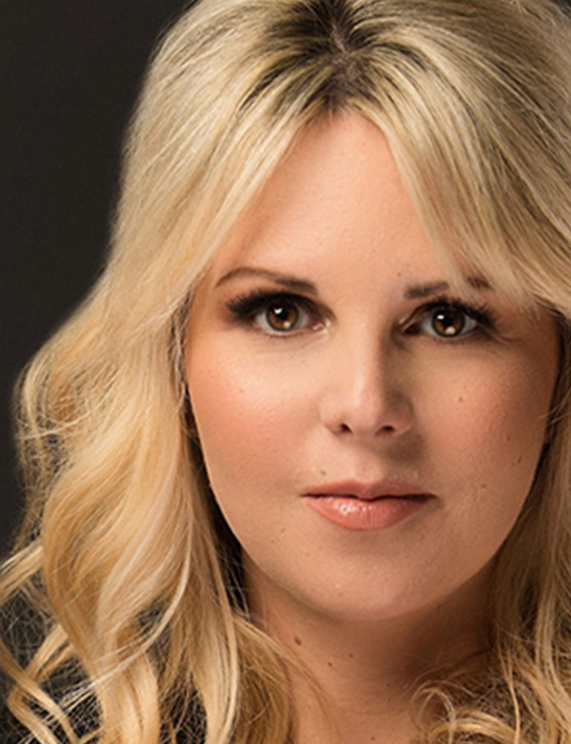
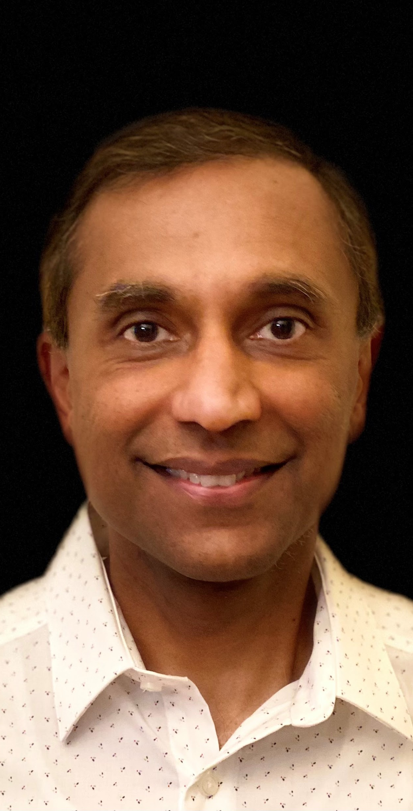
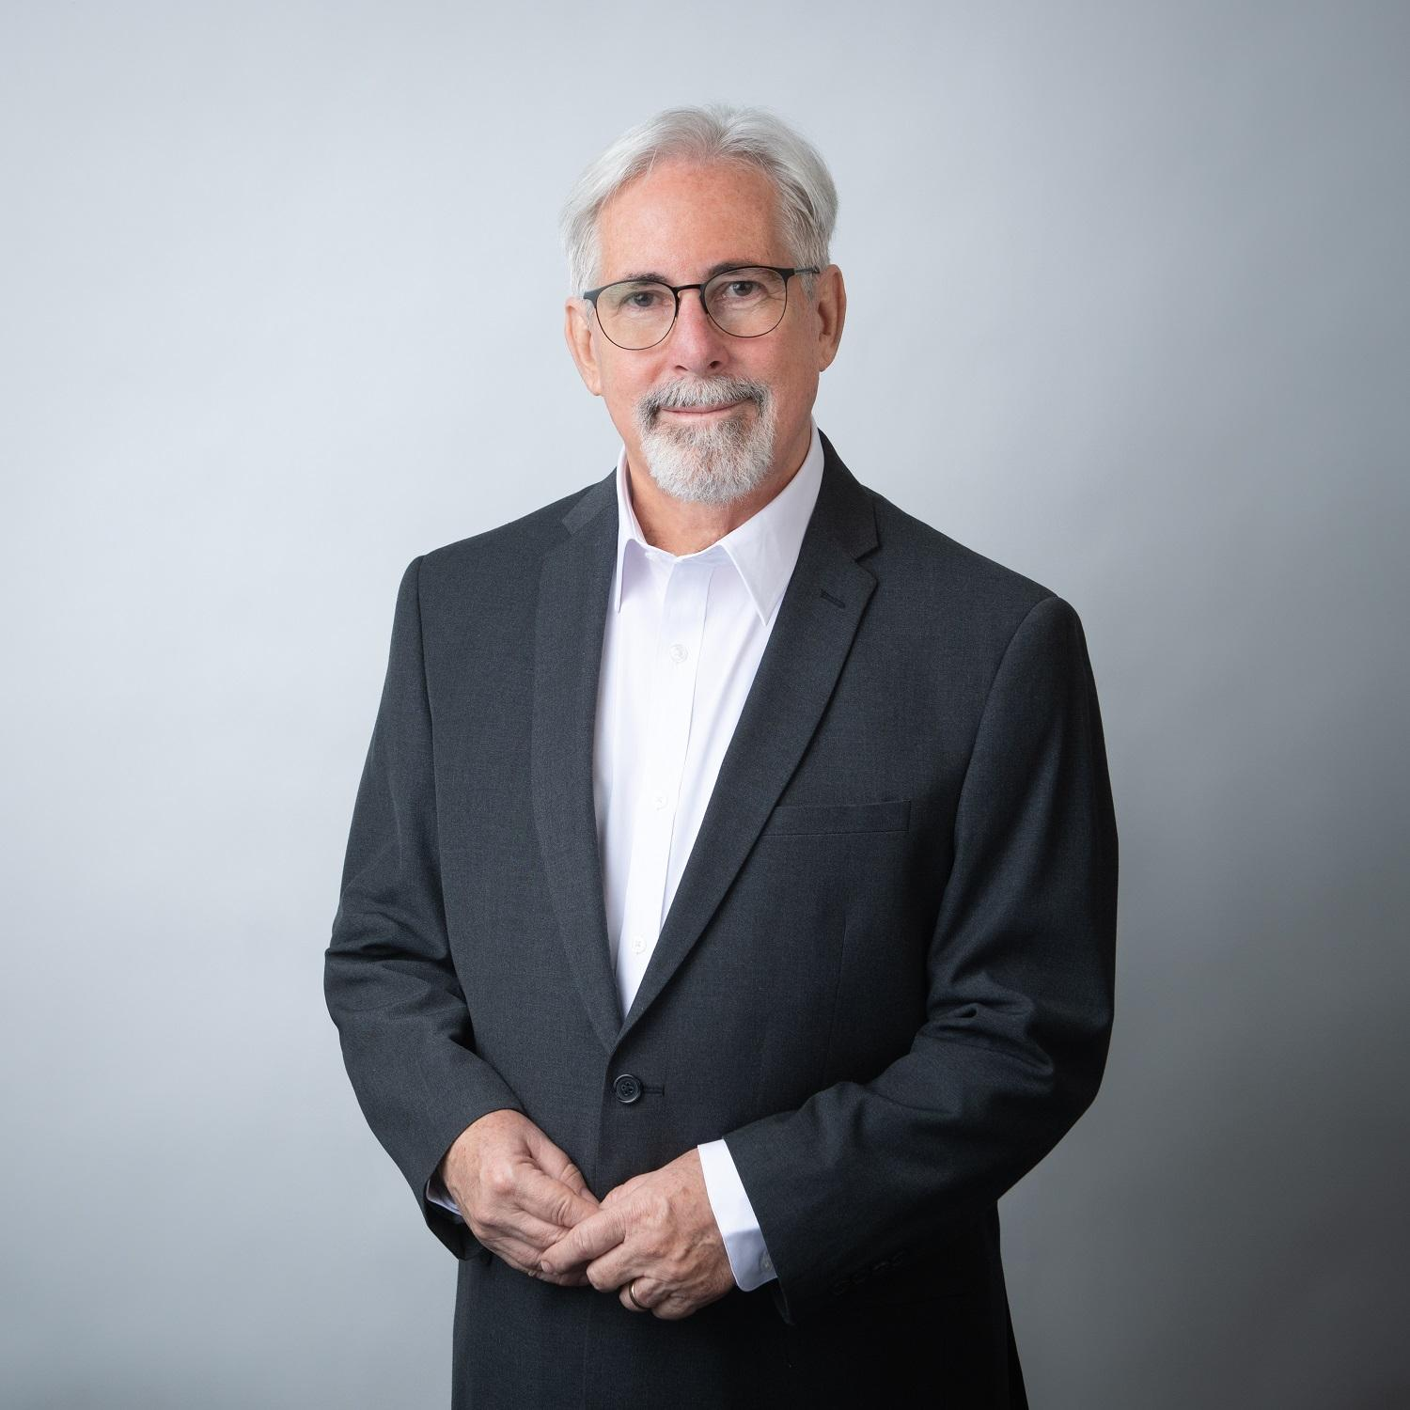
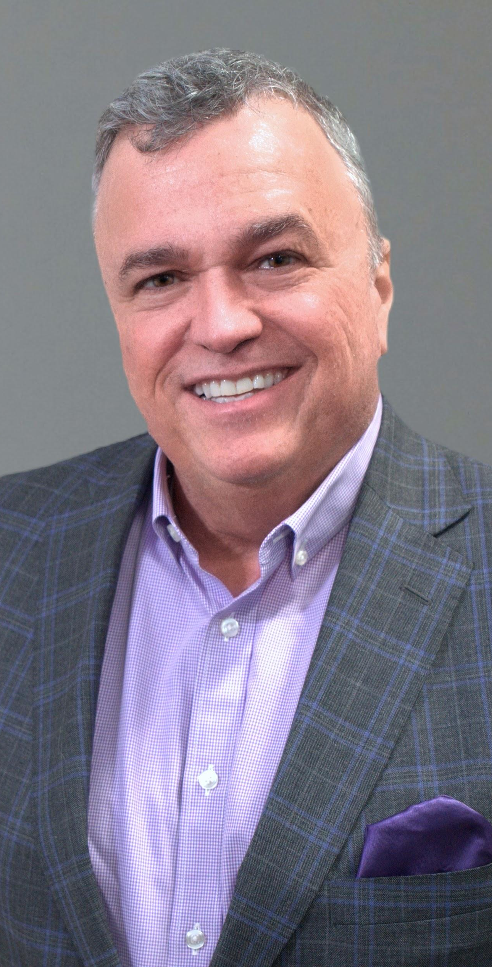
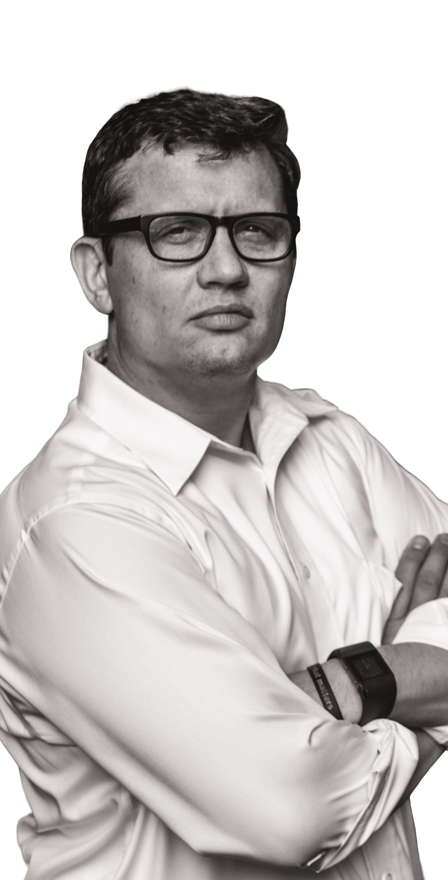
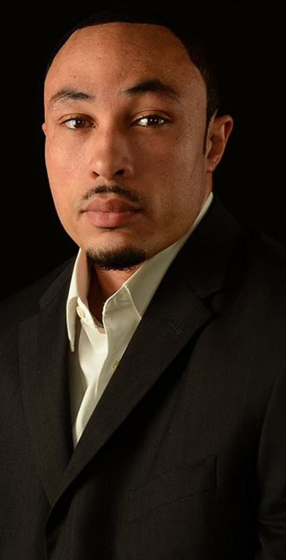
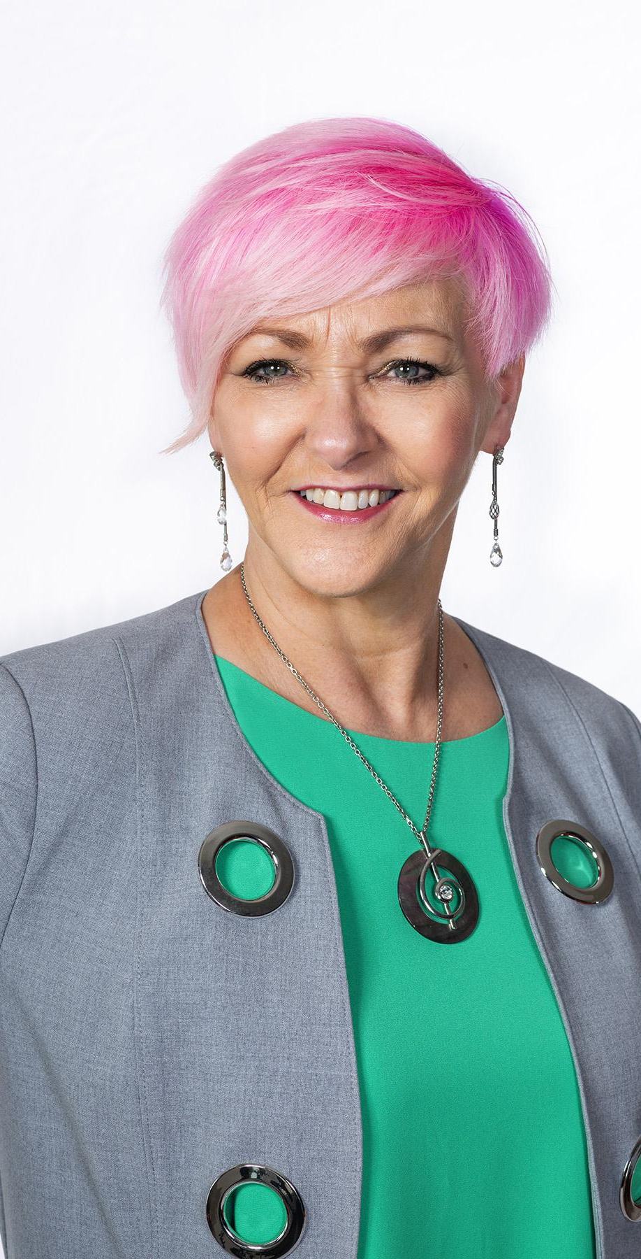
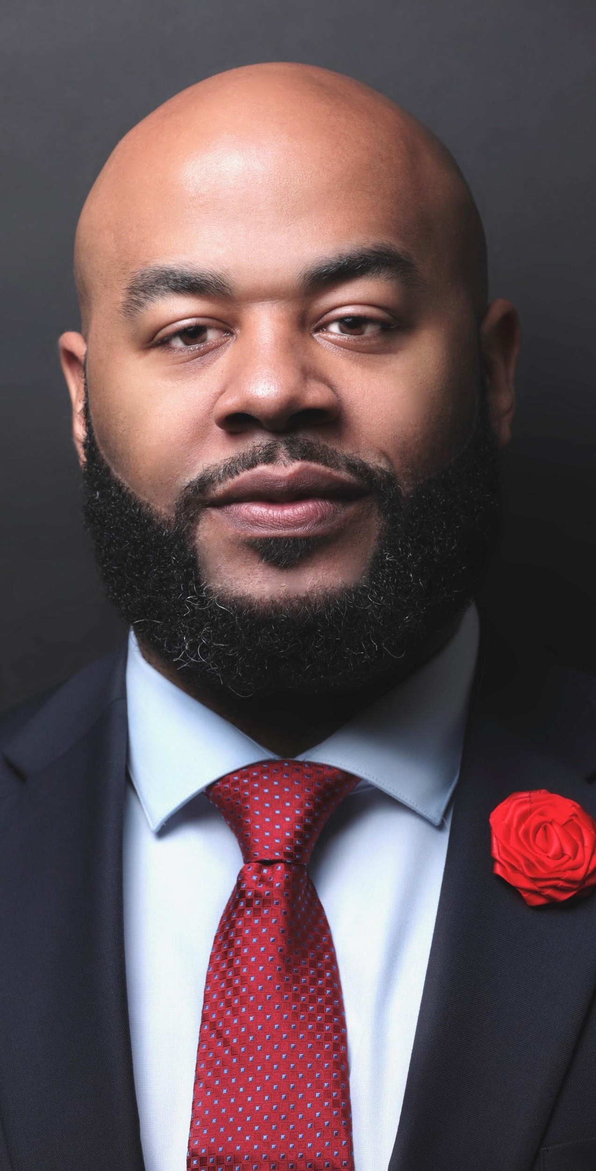
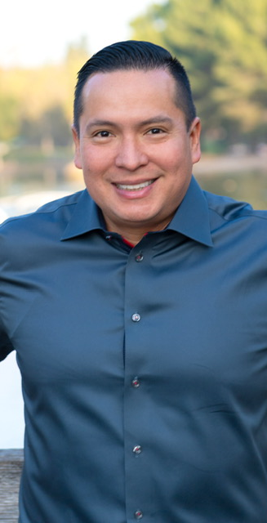
42 Speakers

Slide 3
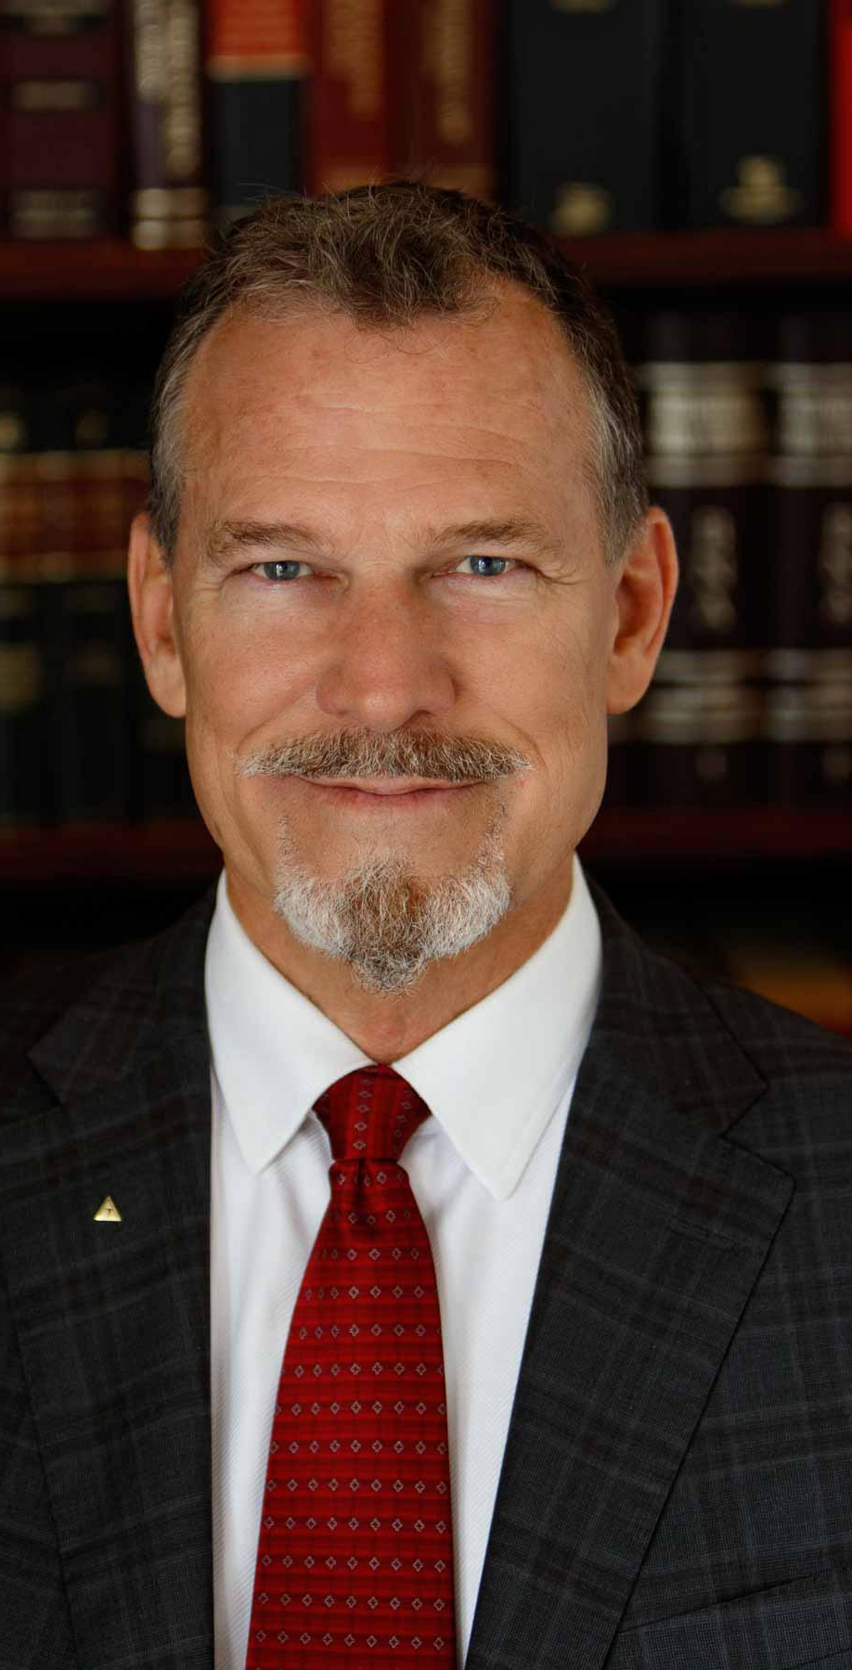
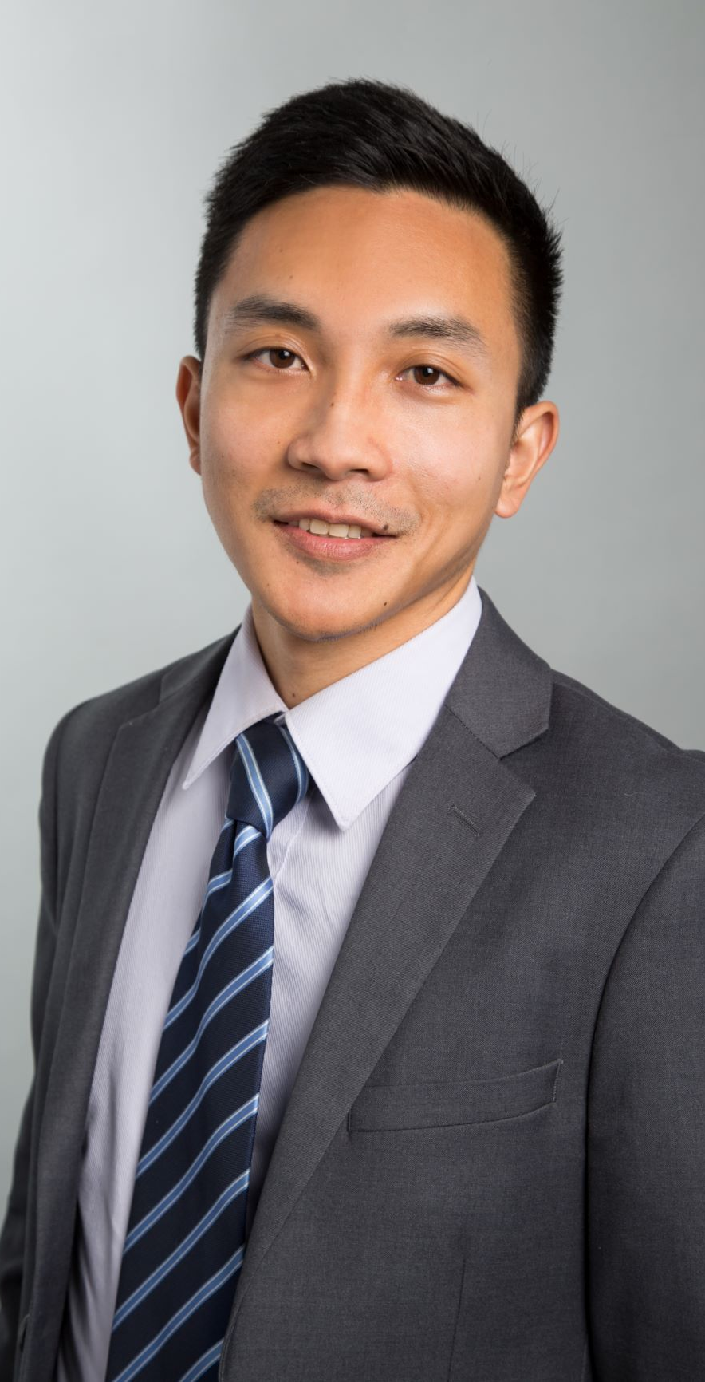
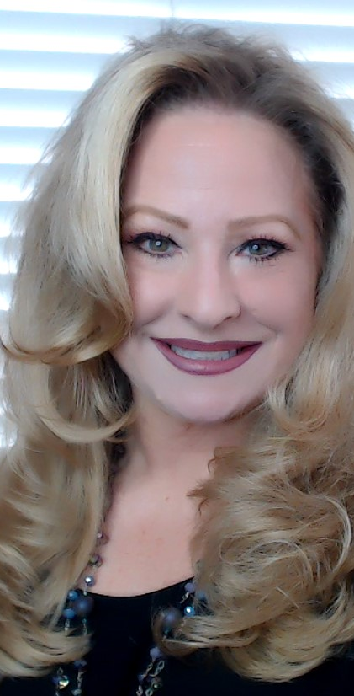
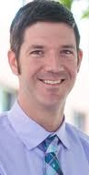
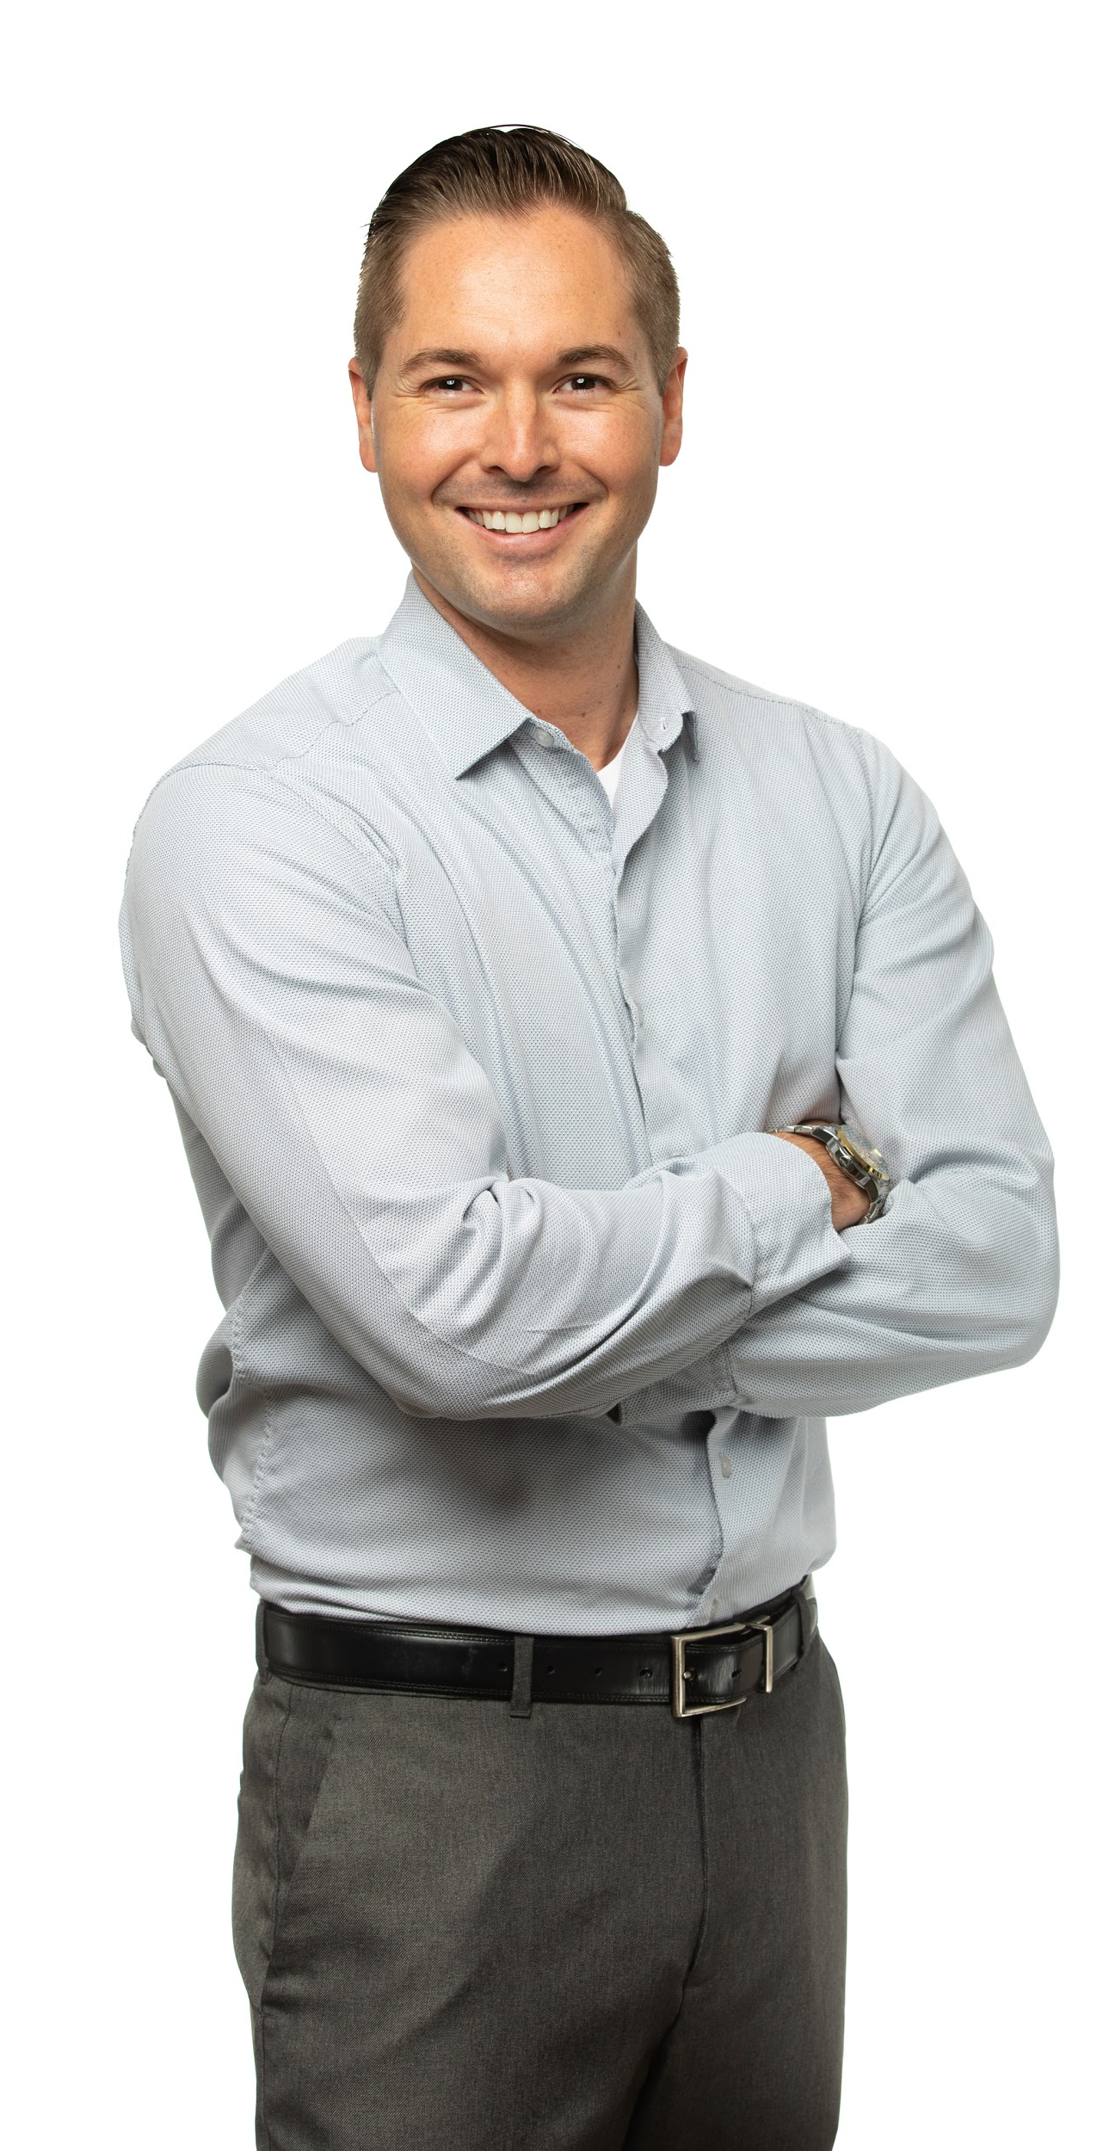
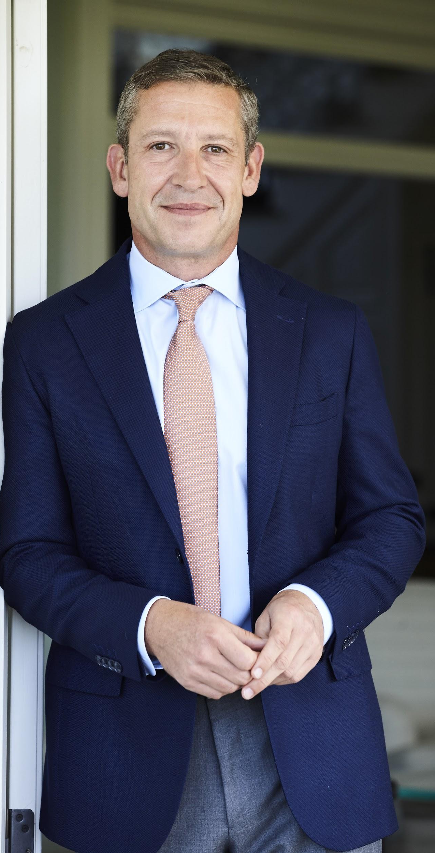
7 full days

Slide 4
HUGE TARGETED AUDIENCE
50,000 attendees
Real Estate Professionals
- Realtors - Investors
- Syndicators - Multifamily

Slide 5
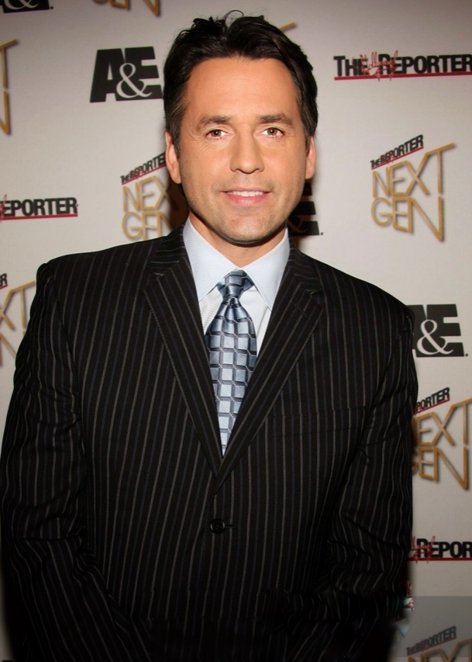
Host:
Tony potts
INTERNATIONAL EMMY-WINNING PRESENTER ACCESS HOLLYWOOD
25YR+ REAL ESTATE INVESTOR
FORMER MANAGING PARTNER SIERRA MAYA 360 VC
https://realestatemasterssummit.com/speakers/

Slide 6
WORLD RENOWN
PRESENTERS

Slide 7
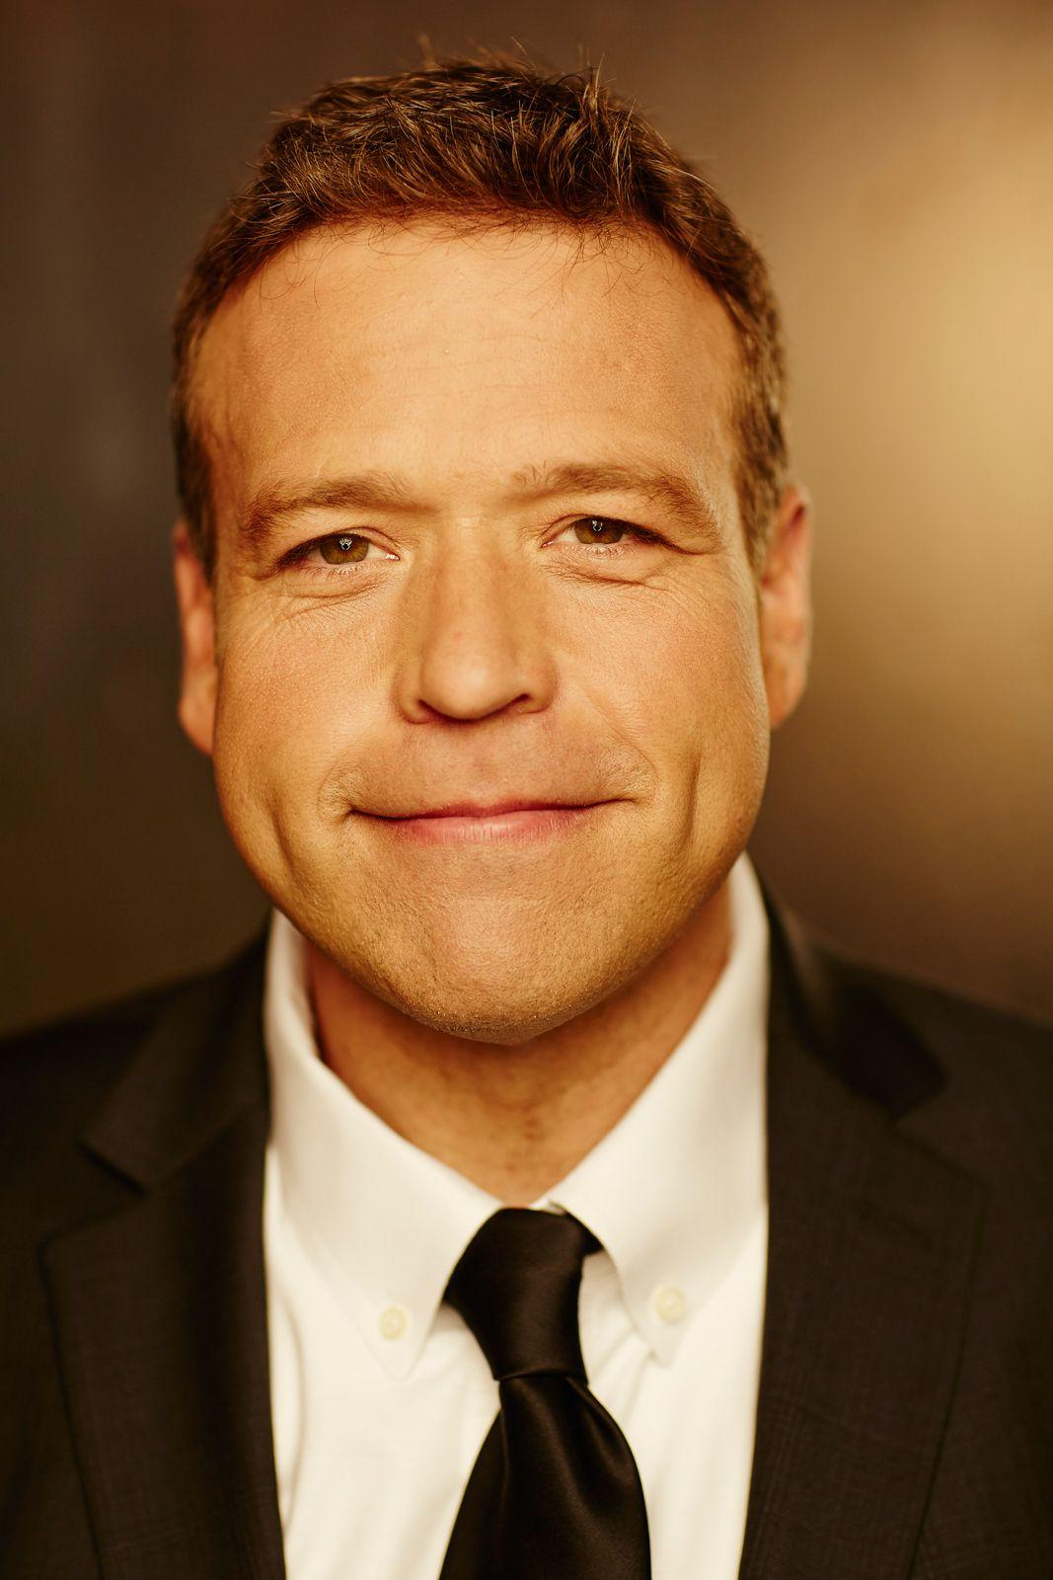
Don will present on how to clarify your message so customers will listen.
Don will explain how to create a marketing narrative that puts your customer in the shoes of the “hero.”
Don will help YOU apply those same principles, get a marketing makeover, and finally attract and deeply connect with your ideal clients!
Donald Miller
https://realestatemasterssummit.com/speakers/don-miller/

Slide 8
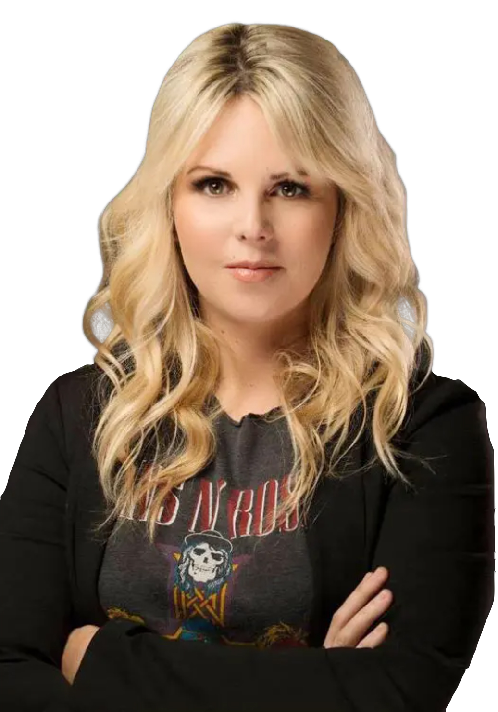
Avery is THE expert in short-term rental investments, Avery has sold over $158 million in 2020.
Avery will give you key guidance in recession-resistant investments to start your investment journey now.
Avery will share her expert-knowledge in connecting investors with short-term rentals with the highest ROI potential.
Avery Carl
https://realestatemasterssummit.com/speakers/avery-carl/
02

Slide 9
Mike’s expertise transformed him from broker to "The Real Estate Marketing Dude."
Mike will share his tried-and-true strategies to build and sustain a consistent database with lead generation systems marketing.
Mike approaches marketing in a down-to-earth way while bringing you industry-tested methodologies and strategies.
Mike Cuevas
https://realestatemasterssummit.com/speakers/mike-cuevas/

Slide 10
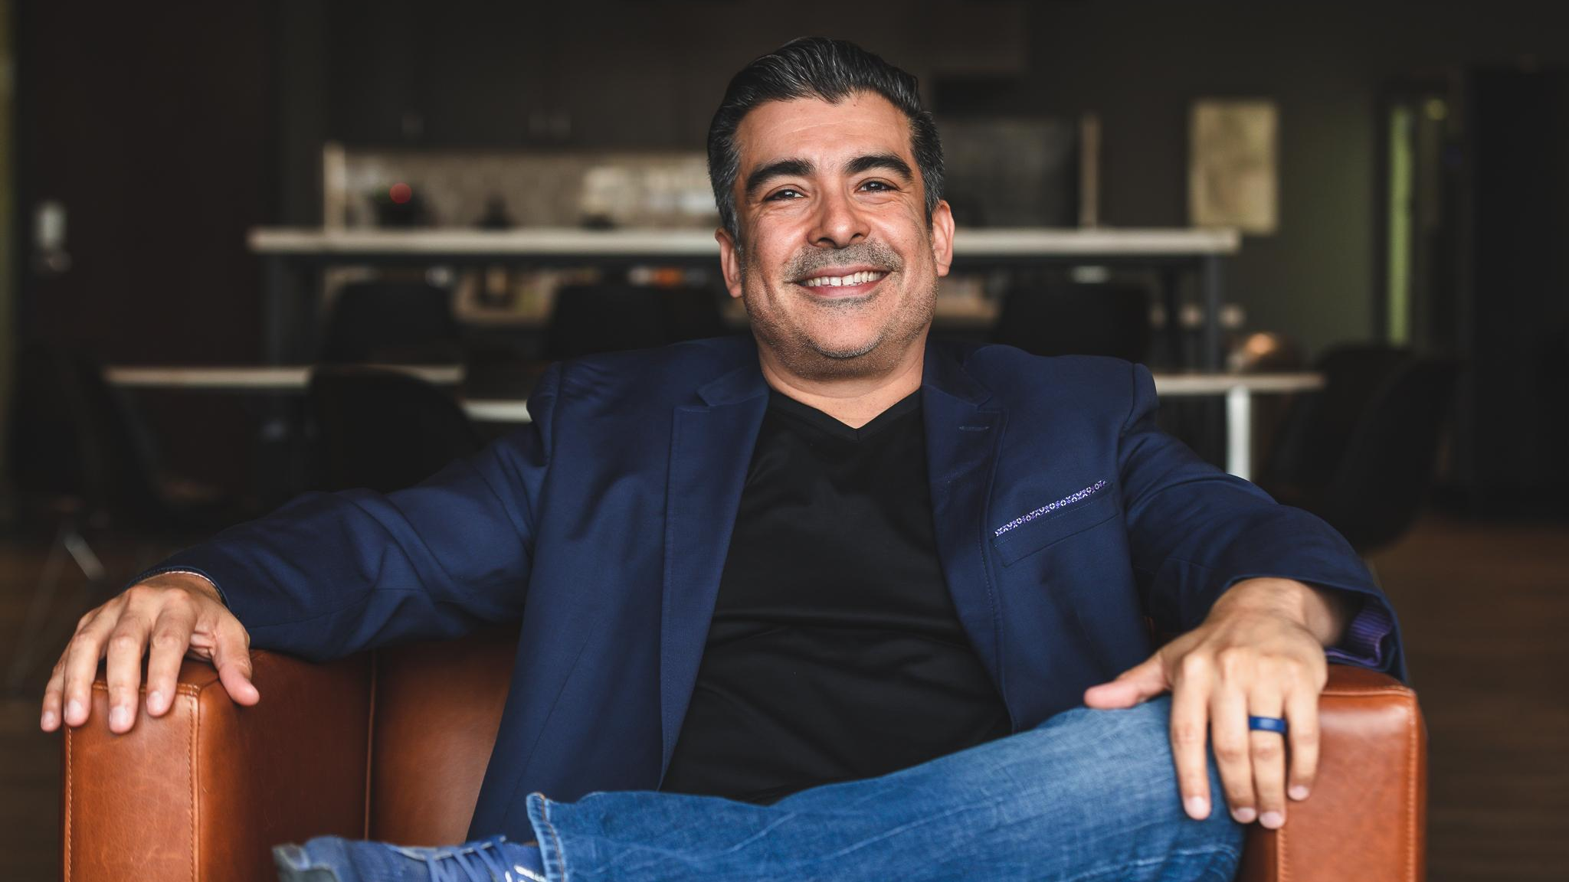
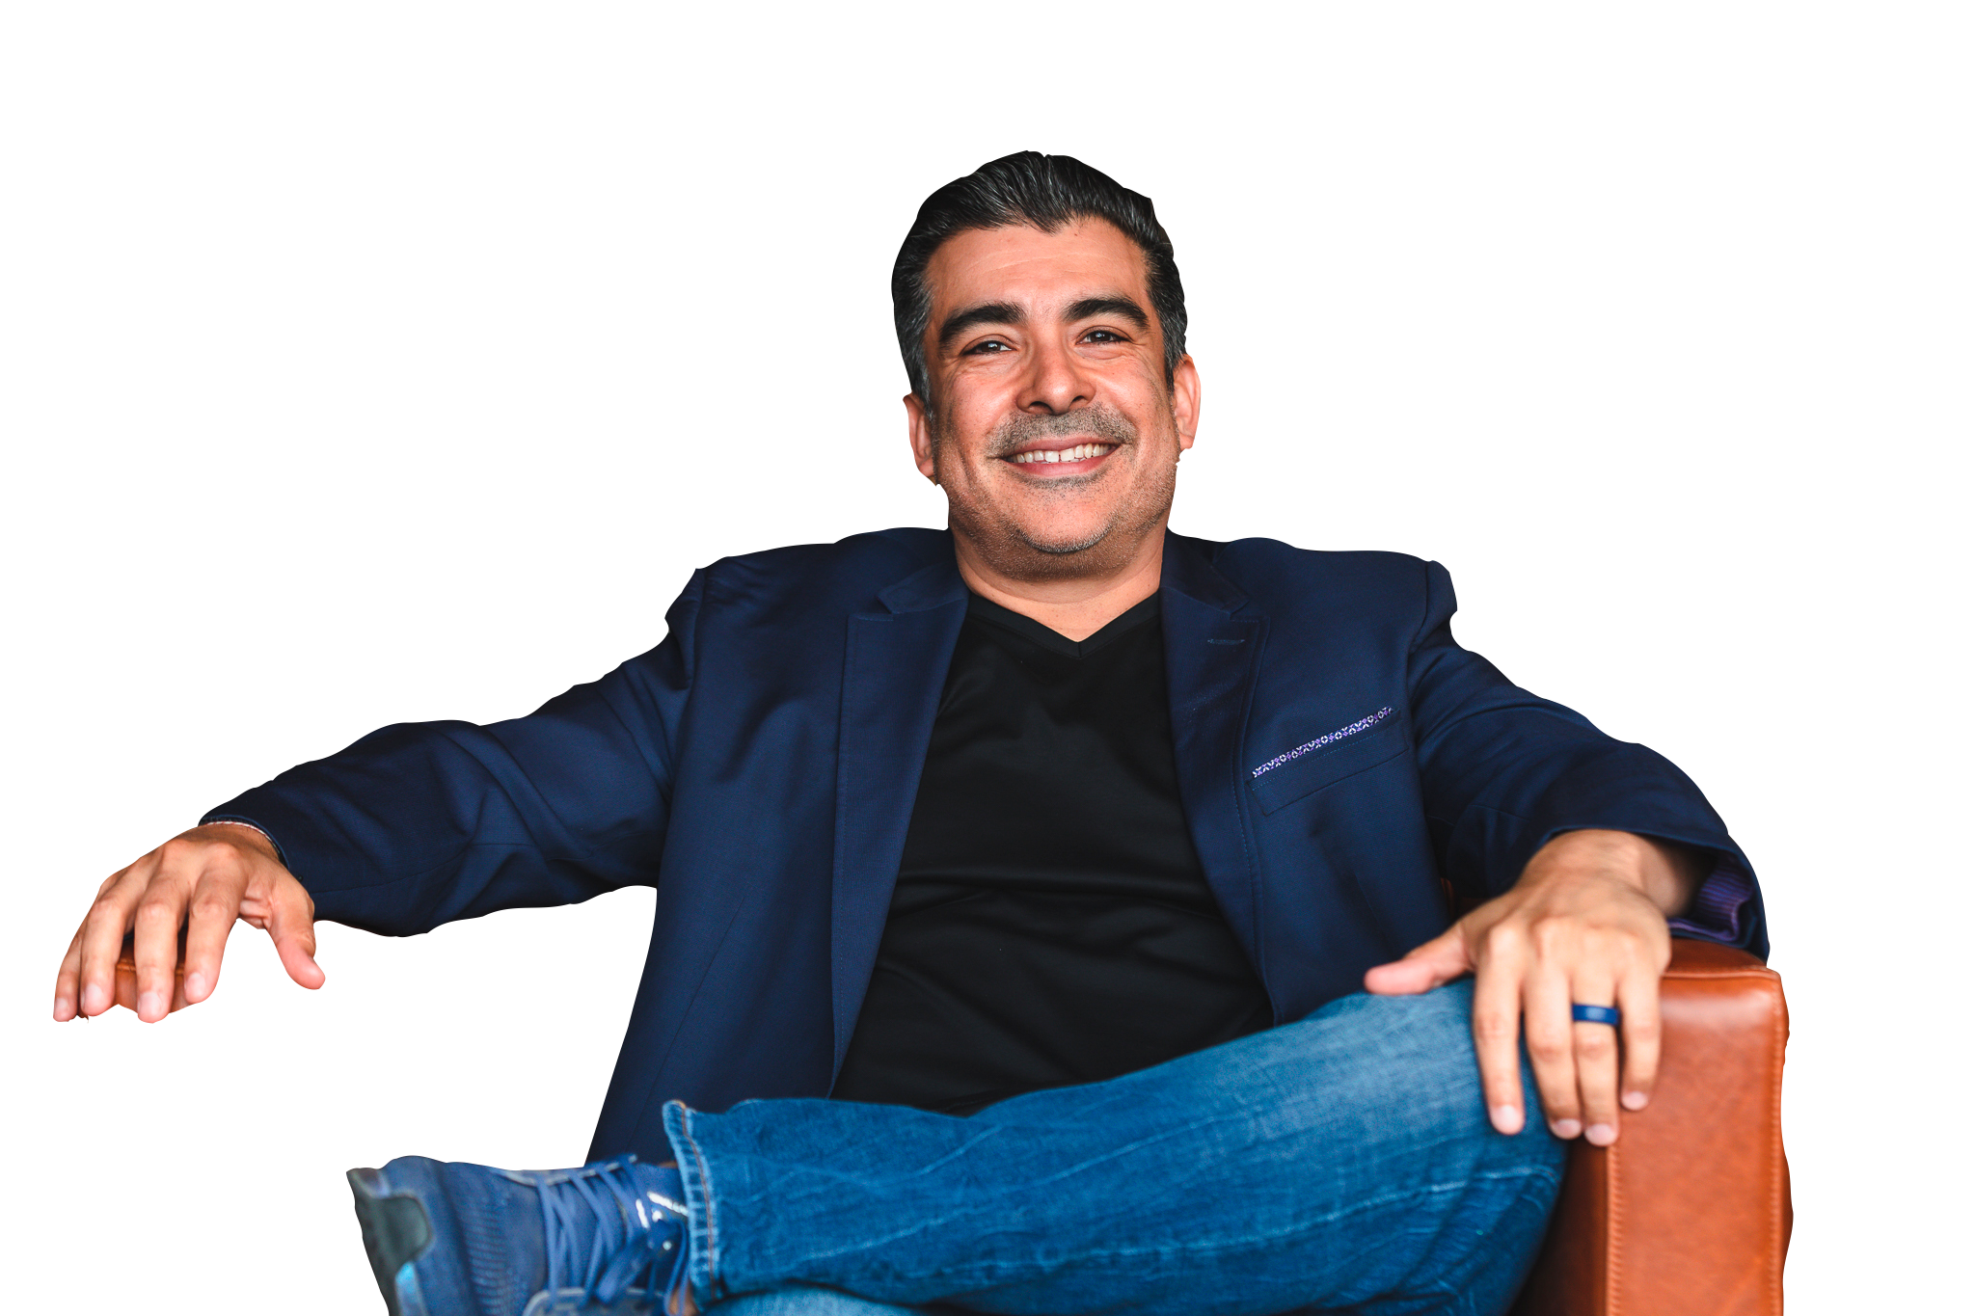
Tristan is CEO of the largest closed real estate Facebook group in the United States, a Fortune 500 consultant, and a leading voice in social media real estate marketing.
In Tristan’s session, he will show you how to apply tried-and-true social media techniques to grow your own business.
Tristan will share how his passion for tech, real estate, and marketing has influenced his formula for higher lead conversion.
Tristan Ahumada
https://realestatemasterssummit.com/speakers/tristan-ahumada/
02

Slide 11
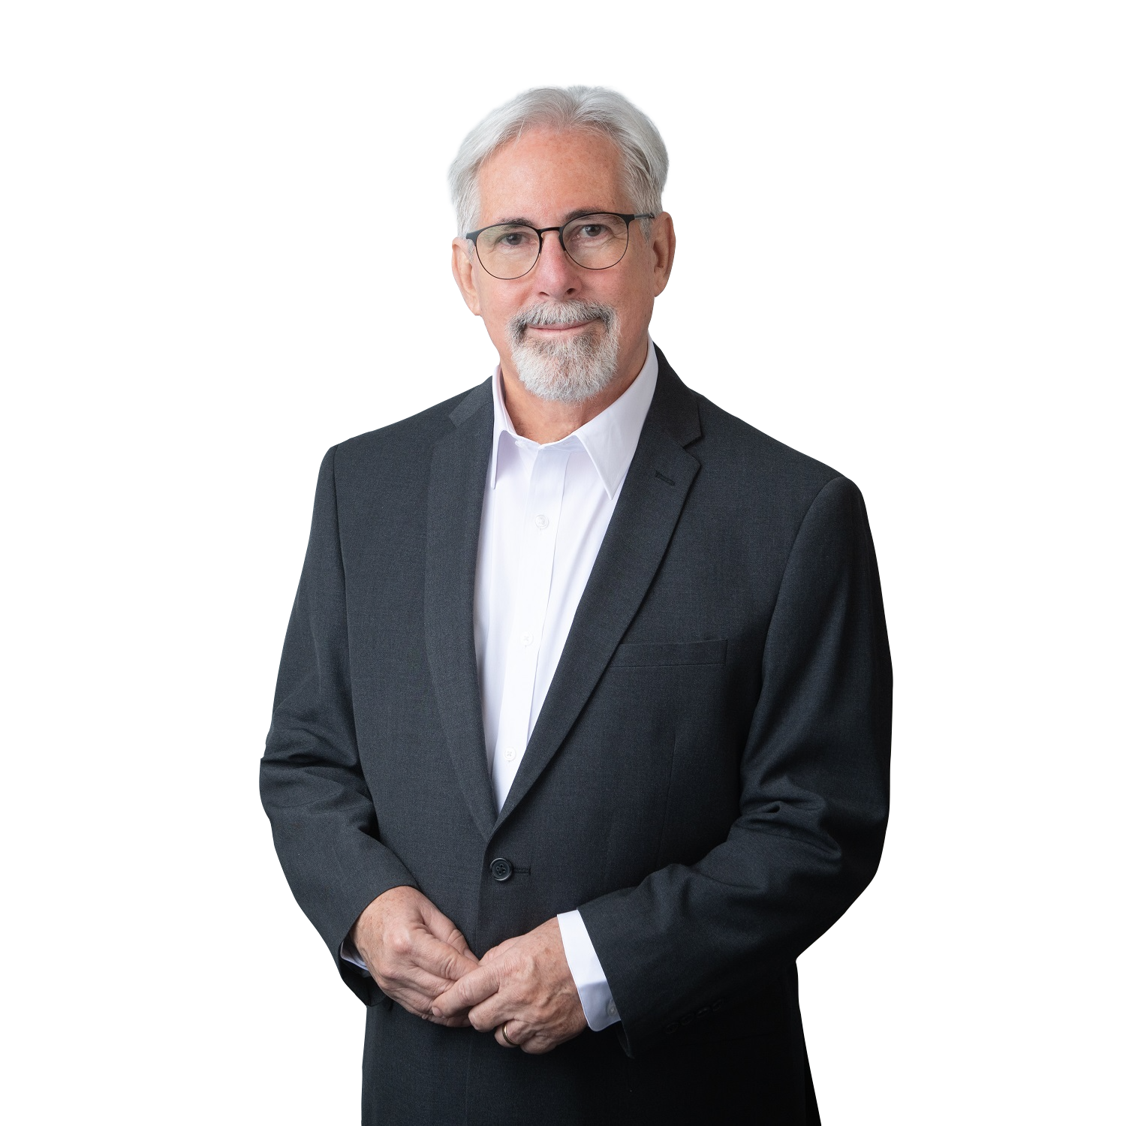
Bill works with investors to educate them on starting real estate investing at a later age.
Bill has found a way to generate cash flow at any age by investing in real estate, and he is here to teach you how to do it.
In this presentation, you’ll receive ten proven psychological "brain hacks" that you can implement immediately!
Bill Manassero
https://realestatemasterssummit.com/speakers/bill-manassero/
02

Slide 12
SPONSORSHIP OPPORTUNITIES

Slide 13
Silver $10,000
Silver sponsorship benefits:
Logo on the Real Estate Master Summit landing page
Free access to summit content
1 FB live to a private group
1 mention by guest speaker
Logo appears on each follow-up email communication with free signs up
1 FB group mention
1 mention by host
10 x All Access Pass = $597 x 10 = $5970
02

Slide 14
GOLD $20,000
Gold sponsorship benefits:
Logo on the Real Estate Master Summit landing page
Logo appears on each follow-up email communication with free signs up
Q&A forum member spot during the broadcast
2 FB live to a private group
Post-launch email offer to 50,000 subscribers
3 mentions by guest speaker
Free access to summit content
Logo appears on each follow-up email communication with early bird sign up members
3 FB group mentions
Pre-launch email blast to 50,000 subscribers
3 mentions by host
20 x All Access Pass = $597 x 20 = $11,940

Slide 15
Platinum $50,000
Platinum sponsorship benefits:
Logo on the Real Estate Master Summit landing page
Logo appears on each follow-up email communication with free signs up
Q&A forum member spot during the broadcast
7 FB group mentions
1 FB Pixel of 50,000 attendees
Post-launch email offer to 50,000 subscribers
7 mentions by guest speaker
Free access to summit content
Logo appears on each follow-up email communication with early bird sign up members
1 Guest speaker spot
3 FB live to a private group
Pre-launch email blast to 50,000 subscribers
7 mentions by the host
50 x All Access Pass = $597 x 50 = $29,850
02

Slide 16
Thank you
Real Estate Masters Summit
+1 323-457-4087
info@realestatemasterssummit.com
https://realestatemasterssummit.com/

